Slide 1
Sugar, the next tobacco

Slide 2
Sugar and Diabetes
Type 2 Diabetes Facts
10% of the population in the USA has type 2 diabetes.
By 2050, 33% of the US population will have Type 2 Diabetes.
Diabetes is the 7th most cause of deaths in the US with over 104,000 deaths in 2020.

Slide 3


Sugar in Starbuck’s Drinks
American Heart Association recommends a maximum sugar consumption of 30 grams per day on average.
25 grams for women
36 grams for men
Starbucks currently serves 132 items that have more than 30 grams of sugar in per serving.

Slide 4

Starbuck drinks with more than 30 g of sugar

Slide 5
Sugar in Starbucks drinks
Was that graph hard to read?
Can’t fit all the drinks on one page.

Slide 6
Starbuck drinks with more than 30 g of sugar

Slide 7

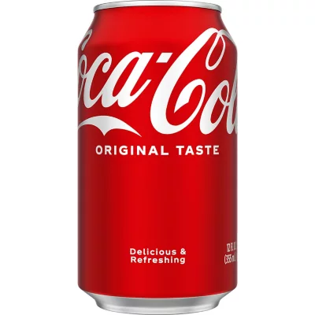

Starbucks vs other drinks
20 oz Gatorade Cool Blue Raspberry
34 grams of sugar
12 oz. can of Coca-Cola
39 grams of sugar
16 oz. Caramel Apple Spice
70 grams of sugar

Slide 8
The Good News
Coffee is a natural fighter of Diabetes
Drinking coffee may reduce your risk of type 2 diabetes. Each daily cup is associated with a 7% lower risk of diabetes.

Slide 9
Recommendations
Reduce the amount of sugar in many of the drinks.
Promote the fact that black coffee helps avert Type 2 Diabetes

